Slide 1




“AI-POWERED ADAPTIVE ONLINE LEARNING PLATFORM”
TEAM MEMBERS
Syeda Andleeb Zehra & Umer Mehboob Khan
SUPERVISOR
Mr. Syed Muhammad Waqas
Iqra University, Department of Computer Science | 3rd July 2025

Slide 2


INTRODUCTION & PROBLEM STATEMENT
Most e-learning systems give the same content to all students
Slow learners get left behind, fast learners get bored
Teachers cannot track student progress in real-time
Need for a system that gives content based on each student's performance
This problem affects students, teachers, and schools/universities

Slide 3
OBJECTIVES & SCOPE
OBJECTIVES
Provide personalized learning for each student
Use AI to suggest topics and quizzes
Make role-based dashboards (Admin, Teacher, Student)
Track student progress with analytics
PHASE 1 SCOPE
Only planning and designing
No coding or implementation yet
Work done: requirements, architecture.
Excludes: full development, mobile version, advanced AI
CONSTRAINTS
Used Waterfall Model
Time limited to one semester

Slide 4

LITERATURE REVIEW / RELATED WORK
TECHNOLOGIES STUDIED
Moodle – Fixed content, no personalized learning, limited tracking
Khan Academy – Same learning path, no real-time adjustment, lacks AI
Coursera – Predefined modules, no performance-based changes, static flow
WHAT’S MISSING IN OTHERS
No real-time feedback, no adaptive quizzes, no custom paths
No AI-driven content suggestions or quiz changes
No support for personalized learning experiences
OUR GAP
Use of AI to suggest topics and quizzes dynamically
Provide each student a personalized learning journey
Adjust content in real-time based on performance

Slide 5


METHODOLOGY / APPROACH
DEVELOPMENT MODEL
Waterfall Model (step-by-step process)
Why Waterfall
Easy for academic projects
Fixed phases and clear documentation
TOOLS PLANNED
Frontend: HTML, CSS, JavaScript
Backend: Node.js, Express.js
Database: MongoDB
AI Model: Python
Hosting: Hostinger

Slide 6
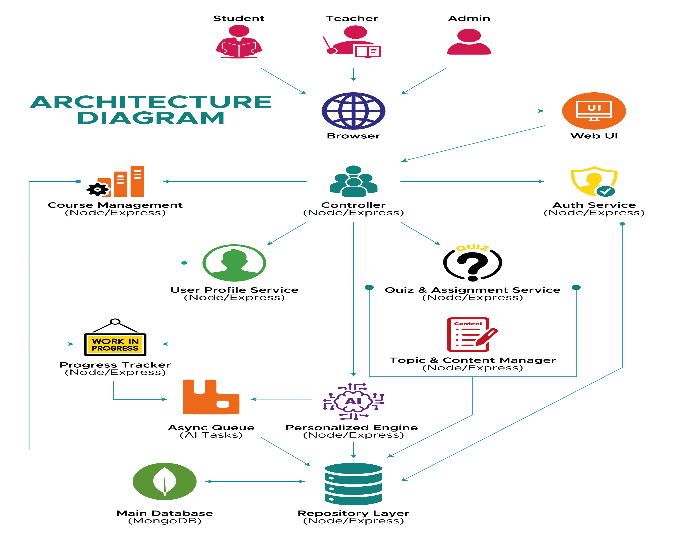

Slide 7
REQUIREMENTS
Functional Requirements | Non-Functional Requirements
Secure user registration & login (student, teacher, admin) | Support at least 15 users simultaneously
Admin credentials predefined by developer | Pages should load within 60 seconds
Profile update: name, email, password, image | Passwords must be securely hashed
Role-based dashboards with limited access | Role-based access control must be enforced
Semester-wise course enrollment with duplicate check | All data transfers must be SSL/TLS encrypted
Admin manages categories, teachers manage subcategories | Admin credentials must remain hidden from users
Topics include title, media, difficulty, prerequisites | Interface should be responsive and user-friendly
Topics linked with quizzes and assignments | Main features should be reachable within 3 clicks
Quizzes: time limit, MCQs, descriptive types | Clear messages for errors and user actions
Assignments: title, due date, attachments | Code must be modular and properly documented
Students attempt content and get AI feedback | Easy maintenance for both frontend and backend
Quiz results include marks, pass/fail, AI analysis
AI suggests personalized topics and practice
Adaptive quizzes assigned with status tracking
Progress tracked per topic/course/semester (Not Started, In Progress, Completed)

Slide 8
CHALLENGES FACED
Understanding Challenges
Adaptive learning and AI concepts were new for us.
Selecting suitable technologies took research.
Documentation Challenges
Making correct UML diagrams was very challenging
Especially Activity Diagram and Use Case took extra effort
Structuring system architecture properly was confusing at first
Time & Coordination
Balancing with other courses and deadlines was difficult
Divided work based on strengths (writing, diagrams, research).
Took supervisor guidance.

Slide 9
Thank You

